Slide 1
Credit EDA Case Study

Slide 2
Problem Statement:
The loan providing companies find it hard to give loans to the people due to their insufficient or non-existent credit history. Because of that, some consumers use it as their advantage by becoming a defaulter.
Also there are times when the banks don’t approve loans to applicants who are not likely to default and hence miss out on making profits.
This case study analyses the existing data using EDA to develop insights on the factors based on consumer attributes and loan attributes that may lead an applicant to default.

Slide 3
Road-map of our Analysis.
This analysis is broadly divided into 4 parts:
1. Data Understanding Data-Cleaning: Apart from getting the feel of application_data.csv, identified data types, missing values, removed the columns with huge missing values, imputed null values, binned continuous variables, identified outliers, handled outliers etc.
2. Data Analysis: Analysing Data Imbalance on Target Variable: Segmented univariate, bivariate analysis and inferences.
3. Correlation between Target and other variables: Finding top 10 correlations and insights from correlation.
4. Analyzing the previous_application.csv data: Merged this dataset with the application_data.csv and performed analysis to obtain insights into historic patterns of loan issuance and payment.

Slide 4
Data Understanding and Data cleaning:
Shape of the dataset: 307511 rows and 122 columns.
Data-types of columns.
Identifying null values.
Removing unwanted columns and imputing null values.
Binning.
Identifying and handling outliers.

Slide 5
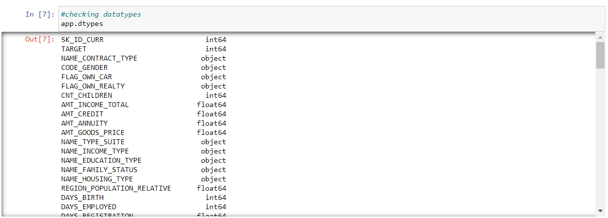
Data-types of columns:
Analysed the data-types of the column values
Count of family members cannot be float. Hence changing the datatype into int.
Deriving a new column Age from DAYS_BIRTH.

Slide 6
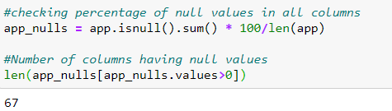
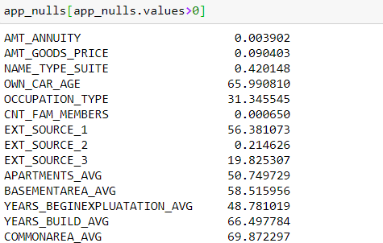
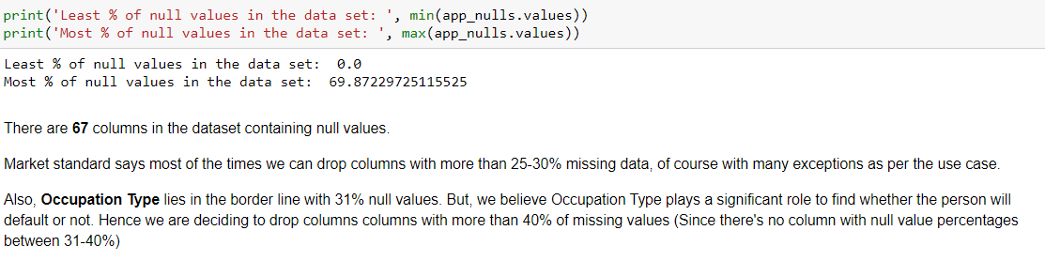
Identifying null values.
Number of rows having null values: 67
The data set has least 0% null values and maximum 69.87% null values.
Based on the inferences we have decided to drop columns with 40% null values.

Slide 7
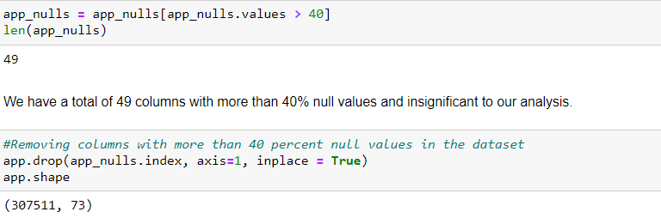
Removing unwanted columns.
After dropping columns having more than 40% null values, we are left with 73 columns.
Dropped columns:
'EXT_SOURCE_2', DAYS_LAST_PHONE_CHANGE,
'EXT_SOURCE_3', 'OBS_30_CNT_SOCIAL_CIRCLE',
'DEF_30_CNT_SOCIAL_CIRCLE', 'OBS_60_CNT_SOCIAL_CIRCLE',
'DEF_60_CNT_SOCIAL_CIRCLE', 'AMT_REQ_CREDIT_BUREAU_HOUR',
'AMT_REQ_CREDIT_BUREAU_DAY', 'AMT_REQ_CREDIT_BUREAU_WEEK',
'AMT_REQ_CREDIT_BUREAU_MON', 'AMT_REQ_CREDIT_BUREAU_QRT',
'AMT_REQ_CREDIT_BUREAU_YEAR’, 'FLAG_MOBIL','FLAG_EMP_PHONE', 'FLAG_WORK_PHONE',
'FLAG_CONT_MOBILE','FLAG_PHONE','FLAG_EMAIL',
'FLAG_DOCUMENT_2','FLAG_DOCUMENT_3', 'FLAG_DOCUMENT_4', 'FLAG_DOCUMENT_5', 'FLAG_DOCUMENT_6', 'FLAG_DOCUMENT_7',
'FLAG_DOCUMENT_8', 'FLAG_DOCUMENT_9', 'FLAG_DOCUMENT_10', 'FLAG_DOCUMENT_12', 'FLAG_DOCUMENT_13', 'FLAG_DOCUMENT_14',
'FLAG_DOCUMENT_15', 'FLAG_DOCUMENT_16', 'FLAG_DOCUMENT_17', 'FLAG_DOCUMENT_18', 'FLAG_DOCUMENT_19', 'FLAG_DOCUMENT_20',
'FLAG_DOCUMENT_21','FLAG_DOCUMENT_11'
Shape of the dataset after dropping all the columns mentioned:

Slide 8
Imputing null values.
Null values were imputed for:
AMT_ANNUITY: Looking at the AMT_CREDIT for rows with AMT_ANNUITY null values, replacing null values with mode(9000.0) doesn't seem to be a good idea. Hence replacing the null values with median(24903.0).
AMT_GOODS_PRICE: Since median and mode both is 450000.0 and it has the highest counts as well imputing again with 450000 might lead to incorrect analysis. Hence imputing it with mean.
OCCUPATION_TYPE: Since the number of null values was high but the column seemed significant, replacing null values with ‘Not Specidied’
NAME_TYPE_SUITE: Replacing null values of this column with maximum occurring value ‘Unaccompanied’.
CNT_FAM_MEMBERS: Since count of family members cannot be guessed on the basis of maximum occurring value or mean, replacing null values with median.

Slide 9
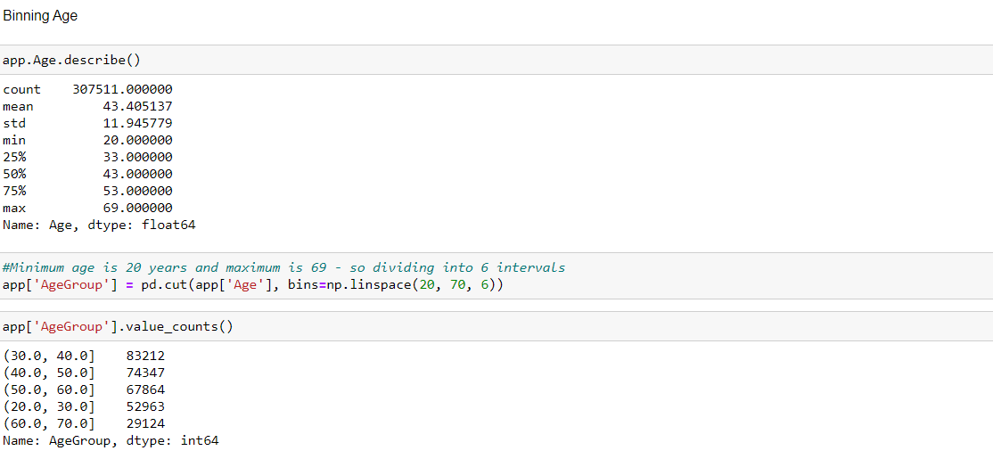
Further data imputations and Binning:
Since Days cannot be negative, replacing the values of these columns with positive values.
Binning the age column which we have created earlier using DAYS_BIRTH into categories:
(30.0, 40.0]
(40.0, 50.0]
(50.0, 60.0]
(20.0, 30.0]
(60.0, 70.0]
By the end of this step we have 22 categorical columns and 13 numeric columns.

Slide 10
Identifying and handling Outliers.
We found outliers in columns:
CNT_CHILDREN, AMT_INCOME_TOTAL, AMT_CREDIT, AMT_ANNUITY, CNT_FAM_MEMBERS, AMT_GOODS_PRICE, DAYS_EMPLOYED.
In case of AMT_INCOME_TOTAL, AMT_CREDIT, AMT_ANNUITY, AMT_GOODS_PRICE, DAYS_EMPLOYED we calculated outliers using the below formula and imputed the values accordingly:
Q1-(1.5 * IQR)<Outlier> Q3+(1.5 * IQR)
where IQR= Q3-Q1.
Q1=25 percentile value, Q3= 75 percentile value.
CNT_CHILDREN : Any value above 4(viz, relatively less) was imputed with 5 and considered as 5 or more for analysis.
CNT_FAM_MEMBERS: Any value above 5 (viz, relatively less) was imputed with 6 and considered 6 and above for analysis.

Slide 11
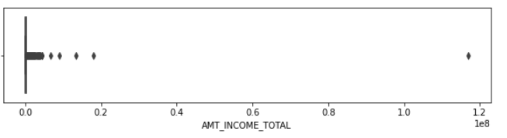
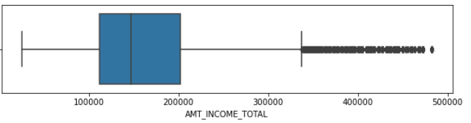
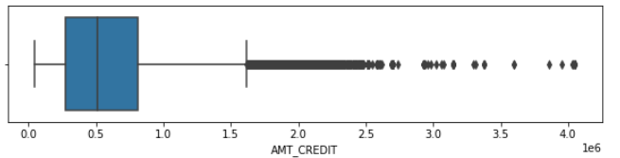
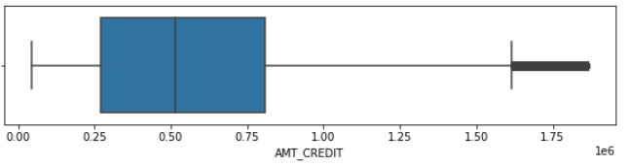
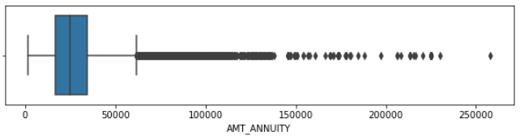
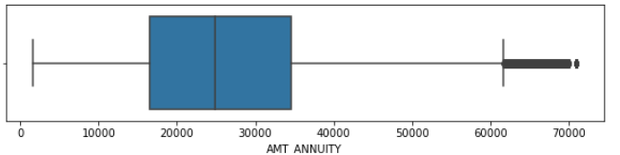
Outliers before and after treating them.
Before treating outliers
After treating outliers

Slide 12
Results of Univariate and Multivariate Analyses together for better visualization:

Slide 13
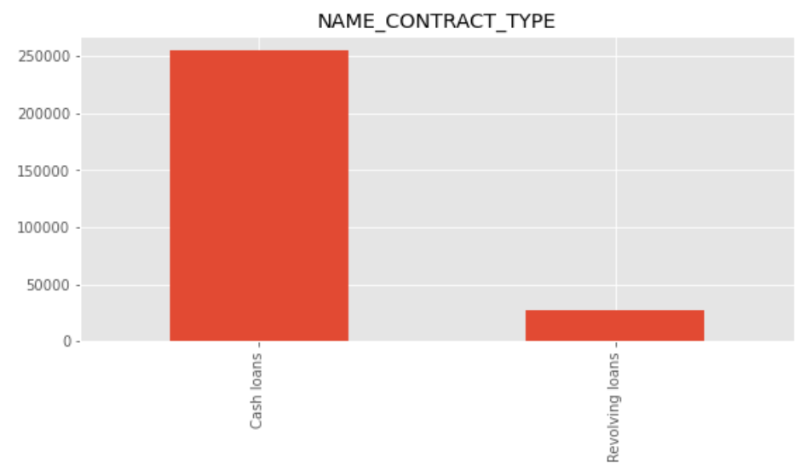
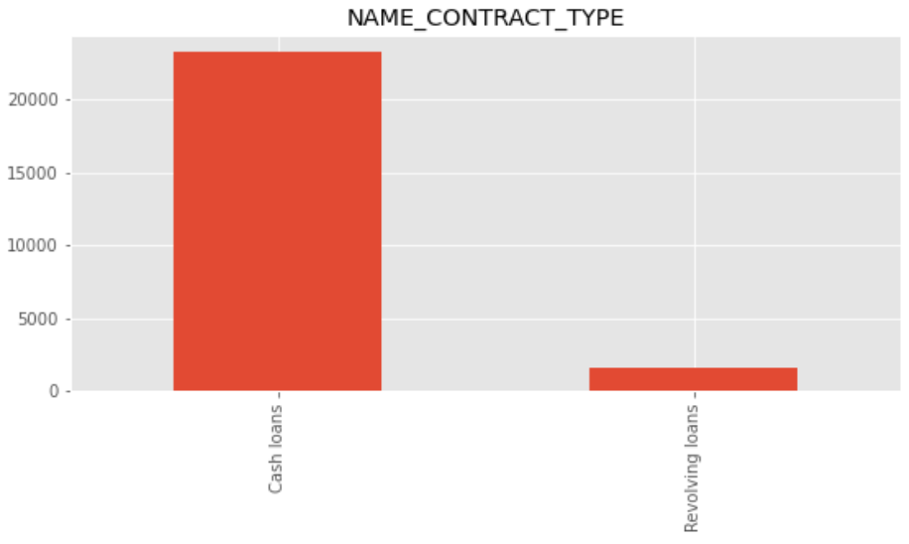
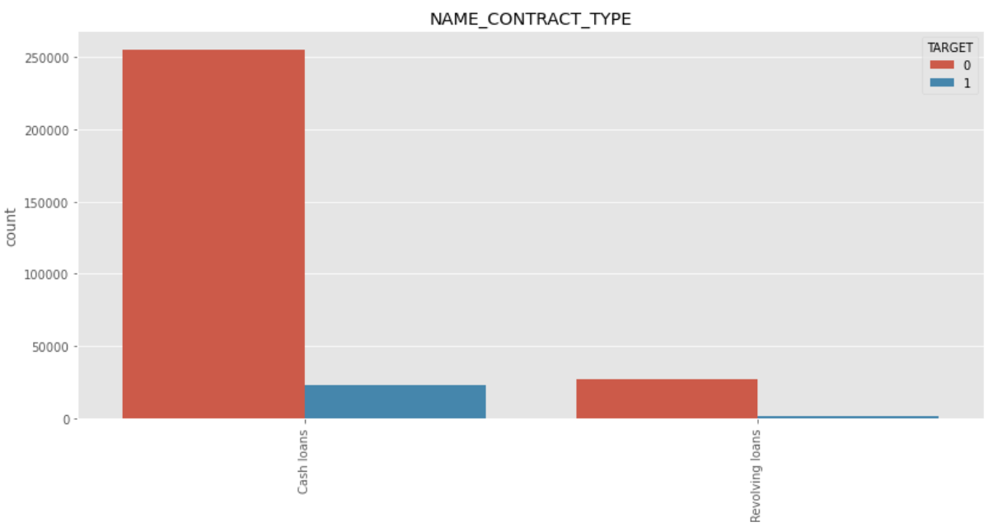
Target 0: More than 2,50,000 applicants have applied for Cash loans and very small proportion of people have applied for Revolving loans.
Target 1: More than 2,0000 applicants have applied for Cash loans and very small proportion of people have applied for Revolving loans.
The proportion of people opting out for Cash loans and paying
the amount back is more than the people opting for revolving loans.

Slide 14
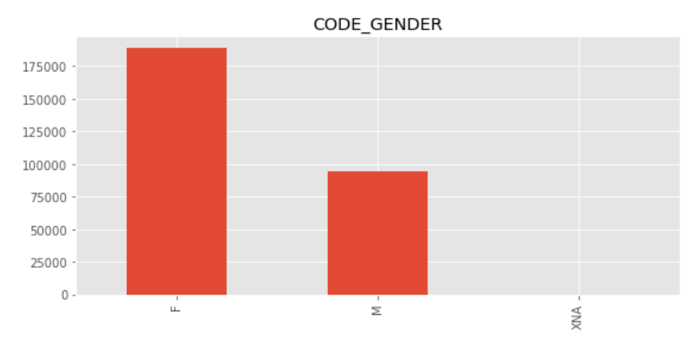
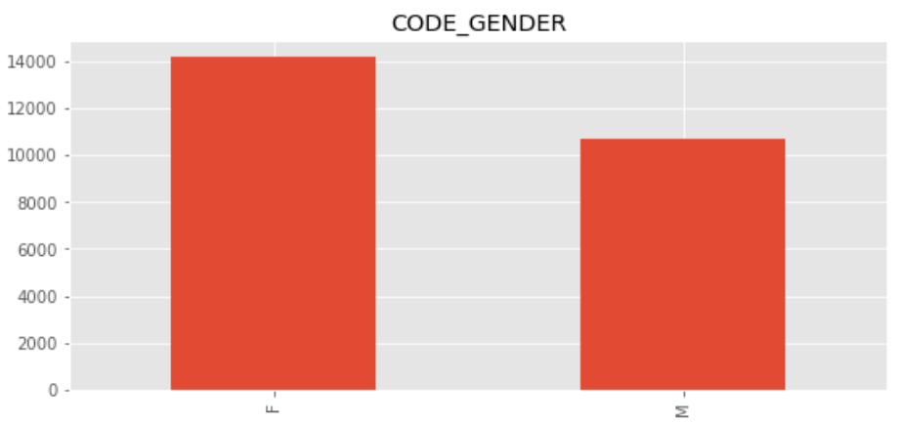
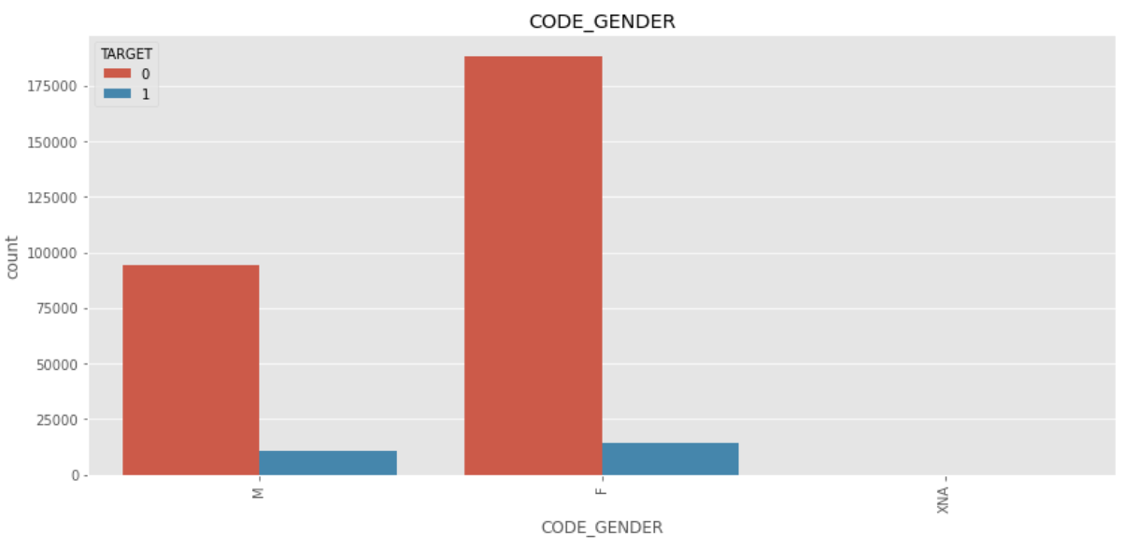
Target 0: More than 175000 loan applicants are female and slightly less than 100000 loan applicants are male and very few(4) applicants have third or unknown
Target 1: Around 14000 loan applicants are female and slightly more
than 10000 loan applicants are male.
The proportion of males applying for loans and having difficulties
in payment is much more than females.

Slide 15
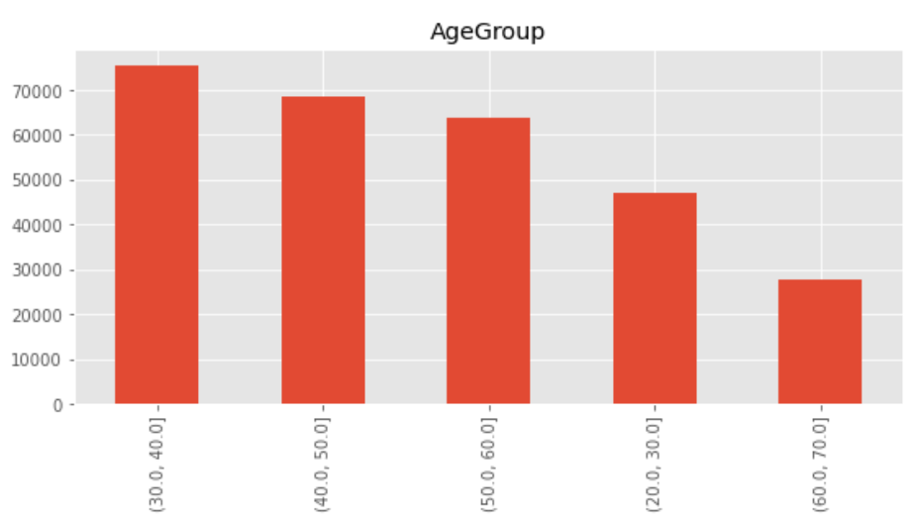
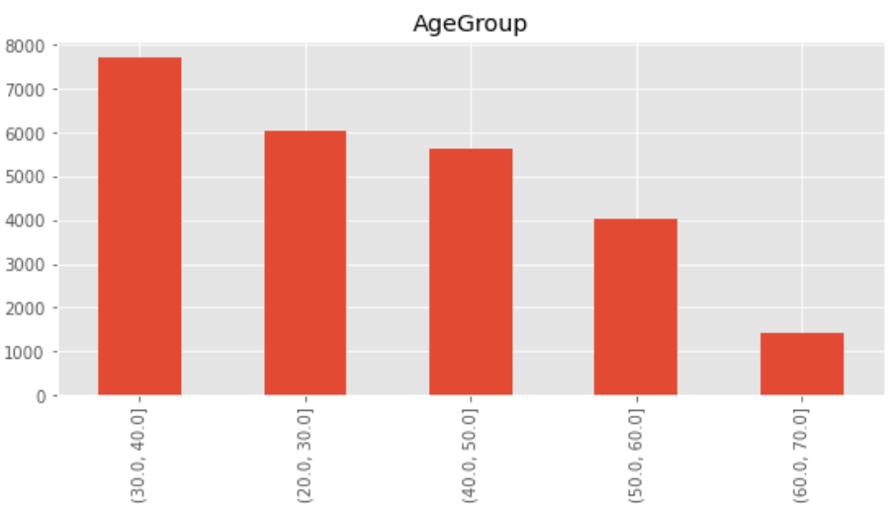
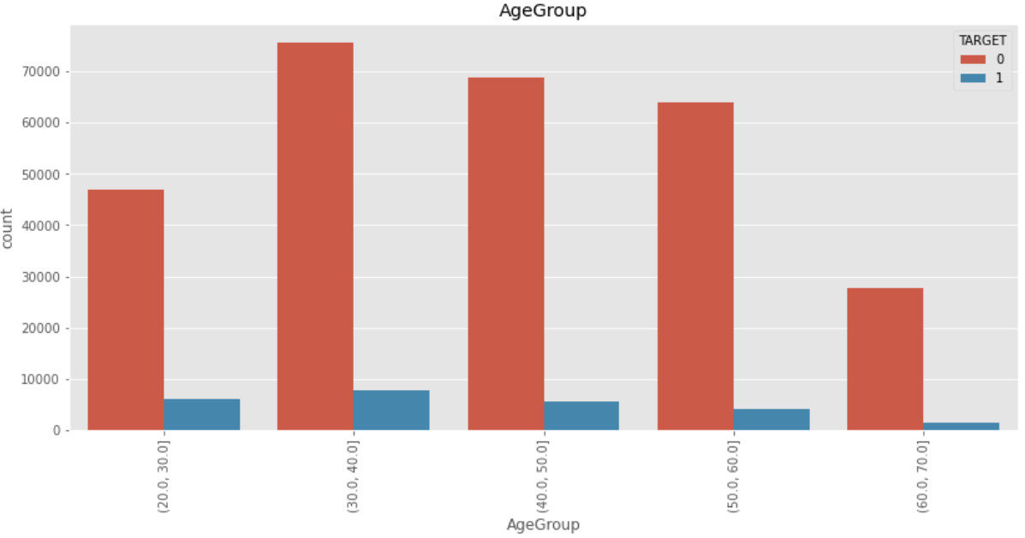
Target 0: People falling under the age group of 30-40, 40-50 and 50-60 are most likely to apply for loan.
Target 1: People falling under the age group of 30-40, 20-30 and 40-50 are most likely to apply for loan
People in the age group 30-40, 40-50 and 50-60 have applied for the most number of loans but applicants in the age group 30-40 have difficulties to pay back the loans.
We can observe a higher trend of defaulters in the lower age groups as opposed to the non-defaulters.

Slide 16
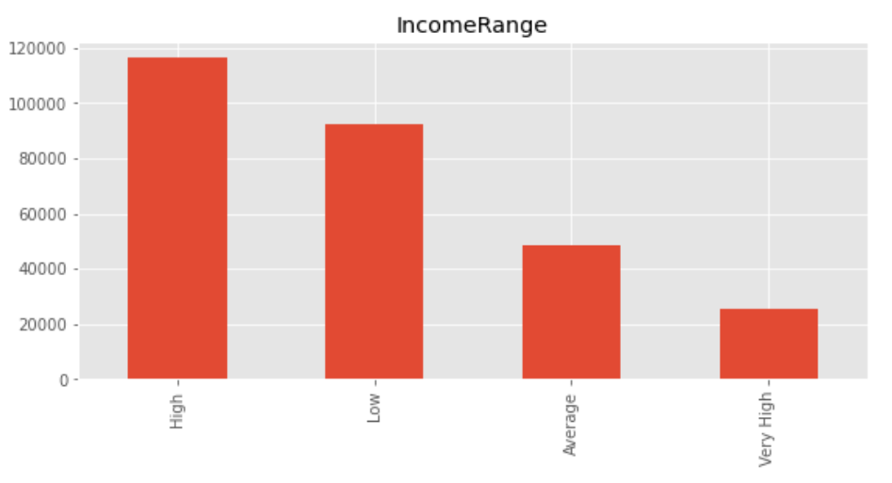
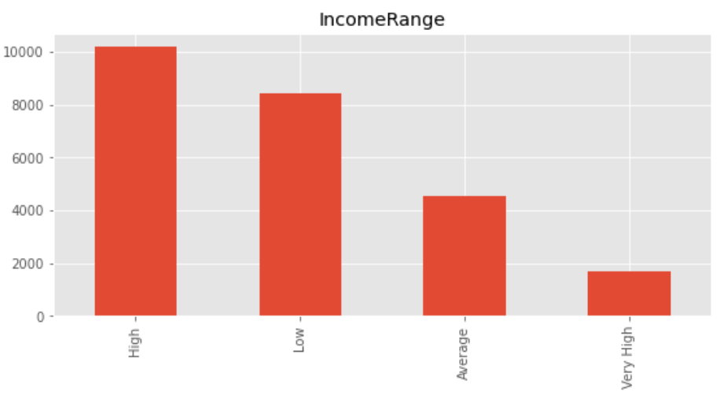
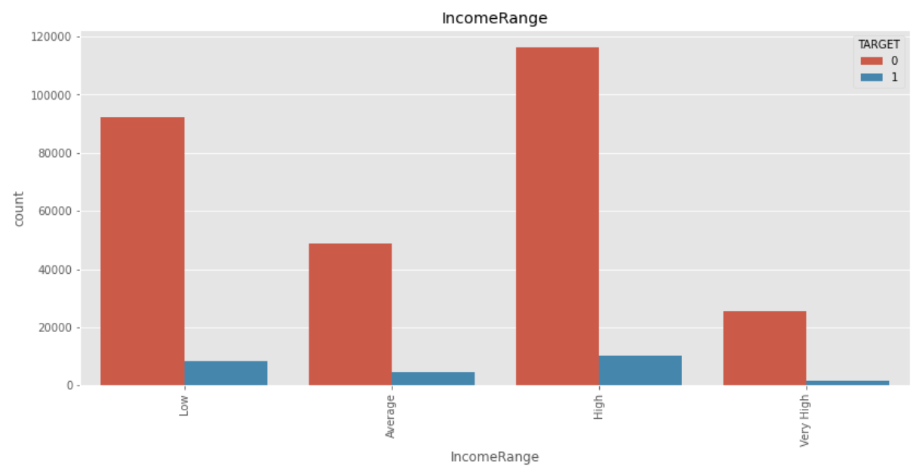
Target 0: There are relatively few people with very high income or average who have applied for loans but most of them who have applied for loans either have high income or low income.
Target 1: There are relatively few people with very high income or average who have applied for loans but most of them who have applied for loans either have high income or low income.
People with high income and low income have applied for the most number of loans(Loans applied by people with high income is much more than the applicants with low income) but people with low income and high income has almost same number of people facing difficulties to pay the loan which means the proportion of people having low income and applying for loans have most difficulties to pay the amount.

Slide 17
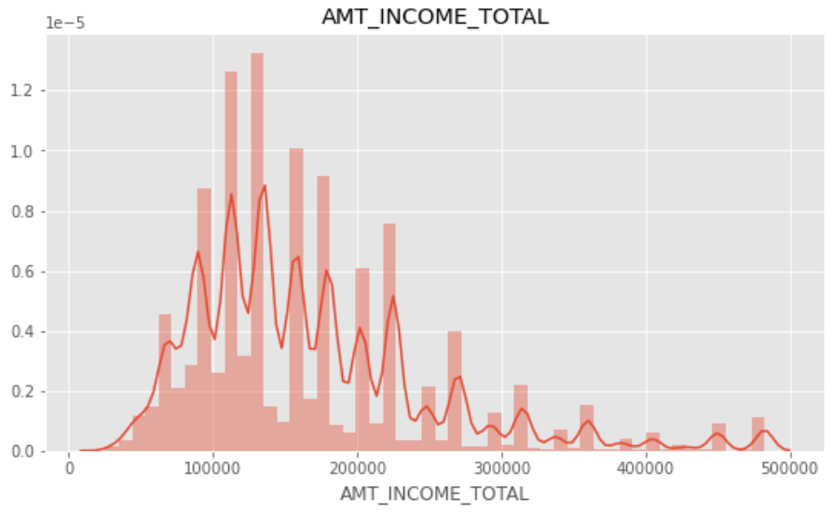
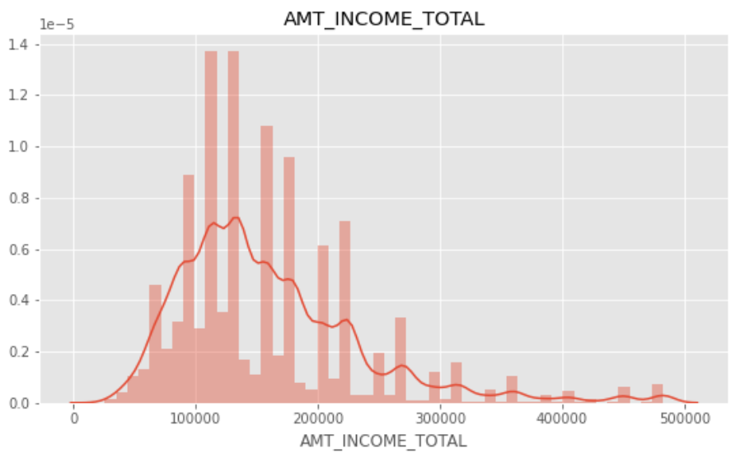
Target 0: The density of people earning between 1,00,000-2,20,000 are more likely to apply for the loans and pay them on time. There is a skew to the right which also shows people with higher salaries present as well.
Target 1: The density of people earning between 1,00,000-1,70,000 are more likely to apply for the loans and pay them on time. There is a skew to the right which also shows people with higher salaries present as well.

Slide 18
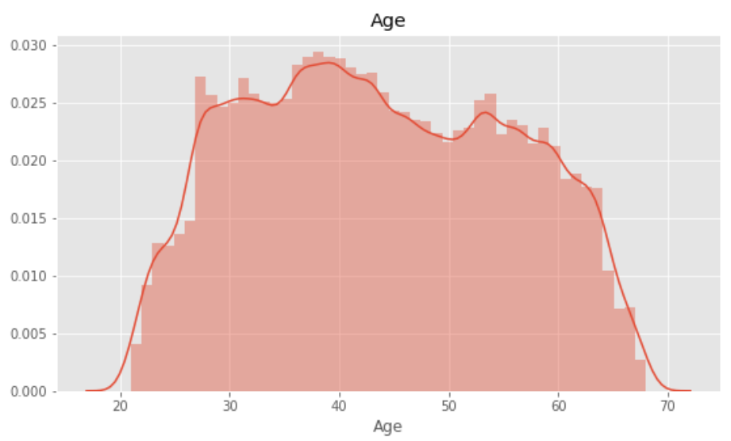
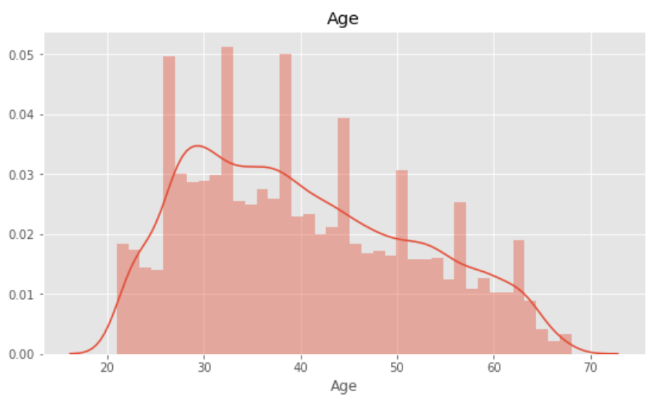
Target 0: Age is almost evenly distributed with maximum density between 35-43.
Target 1: Age is almost evenly distributed with maximum density between 25-38

Slide 19
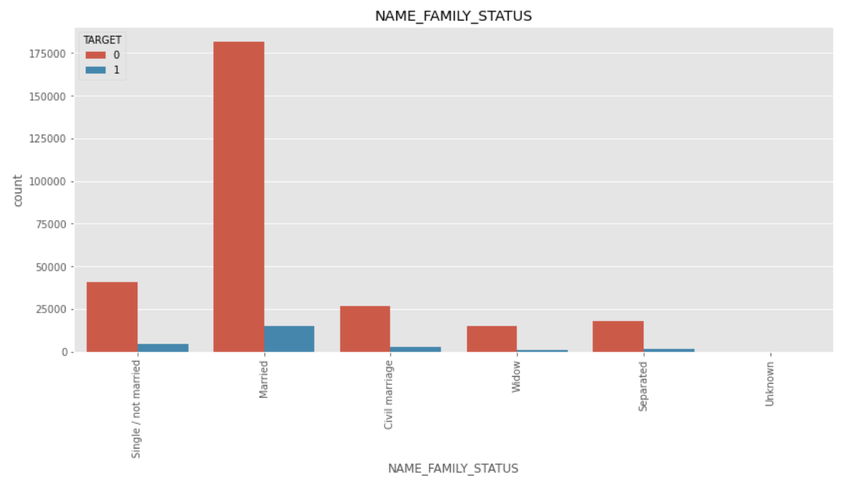
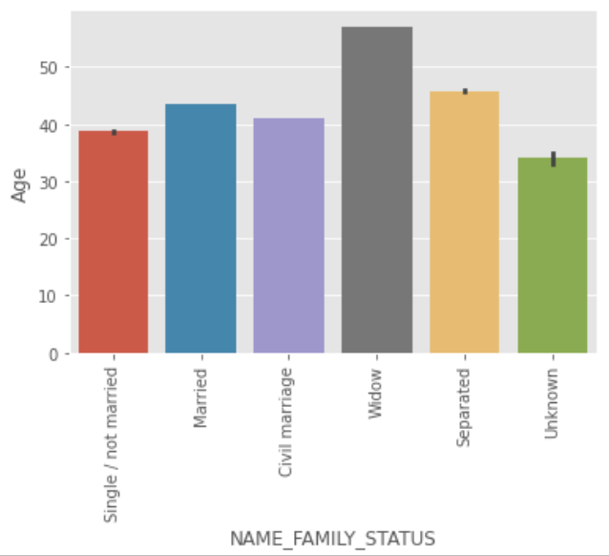
Married people apply for the most number of loans but few percentage of married people have difficulties while paying back the amount.
Where as the proportion of singles/not married who are applying loans and are defaulting is much higher which supports the earlier inference of people in the age group 30-40 to be defaulting most likely.
Mostly people with more age who have applied for loan are either widowed or separated.

Slide 20
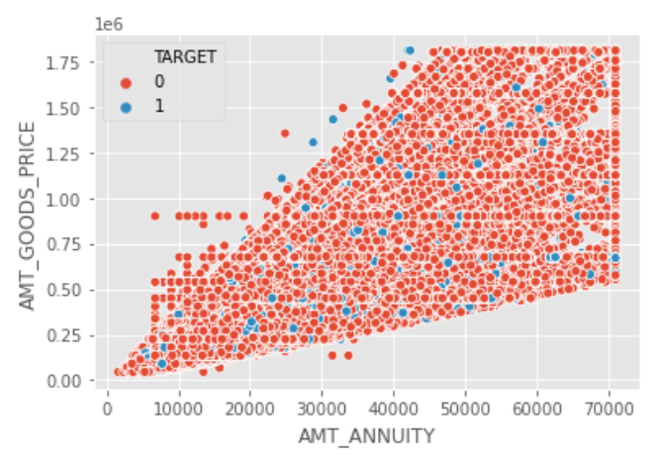
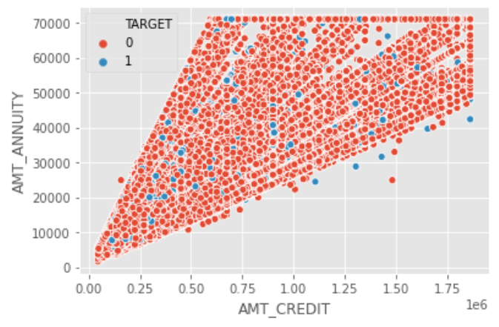
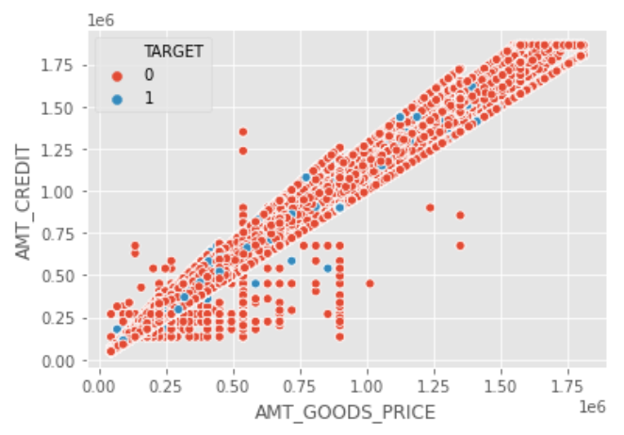
Credit amount and Annuity, Credit amount and Goods price , Annuity and Goods price have a rising relation if not completely linear relation with few exceptions.

Slide 21
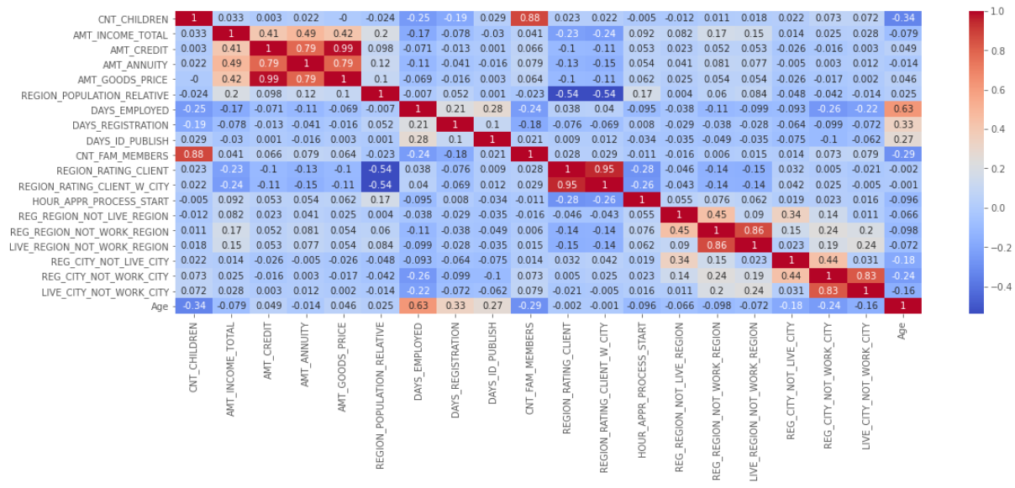
Correlations:
Heatmaps to visualize correlation and derive insights.
Target 0

Slide 22
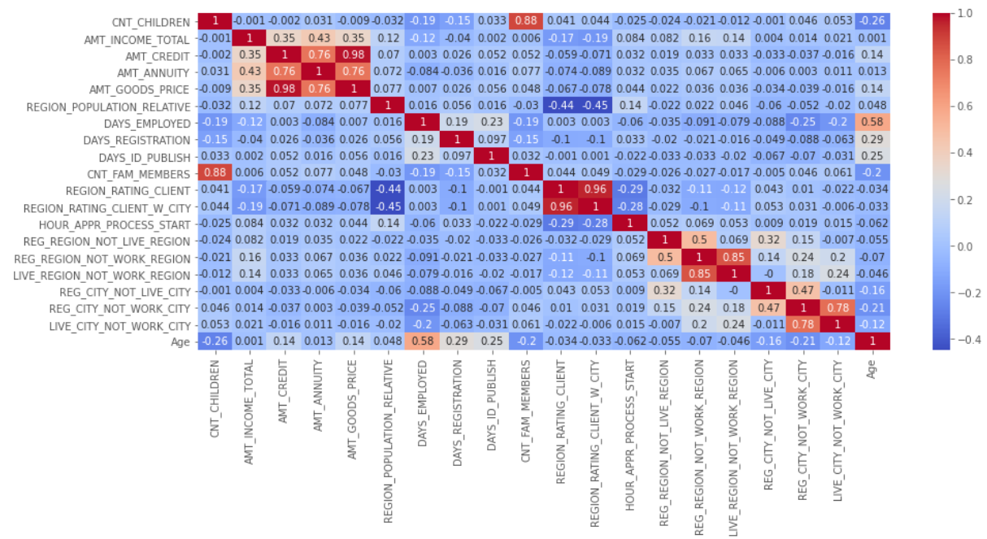
Target 1

Slide 23
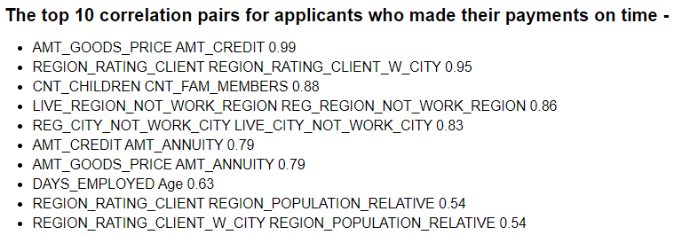
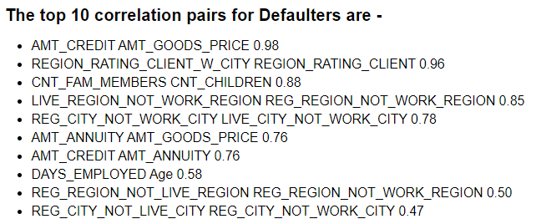
Insights derived from Correlation:
Goods price increases with credit, annuity increases with credit and goods price increases with annuity not entirely linearly. But since it shows a definite pattern which resembles linearity and has relatively high correlation- these 3 variables are directly or indirectly related to each other.
Defaulters have very less correlation between there total income(AMT_INCOME_TOTAL) and series of payments made at equal intervals(AMT_ANNUITY)
For defaulters there is a linearly increasing relation, where there applicants permanent address and city doesn’t match with contact address or city to work address or city.

Slide 24
Analyzing the previous_application.csv data:

Slide 25
Data Understanding and cleaning:
Shape of the dataset: 1670214 rows and 37 columns.
Identifying null values.
Removing unwanted columns and imputing null values.
Merged the dataset with application_data.cav dataset by joining on SK_CURR_ID to obtain historic data for current applicants
Removed the columns for which we have already performed analysis. Used a concise dataset to obtain insights into historic track records of loans of applicants.

Slide 26
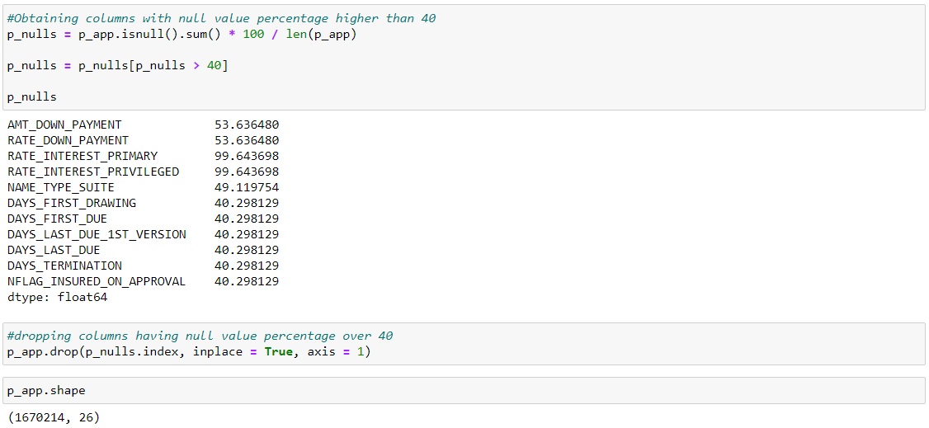
Columns with null values more than 40% are dropped.
After dropping those columns we are left with 26 columns.
The column NAME_CASH_LOAN_PURPOSE has 922661 XNA value.
Considering these rows as null values(since keeping those rows was not deriving any patterns or inferences as such) and hence deleting them for optimum analysis.

Slide 27
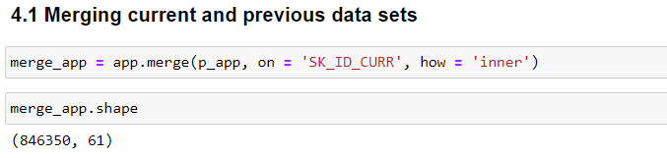
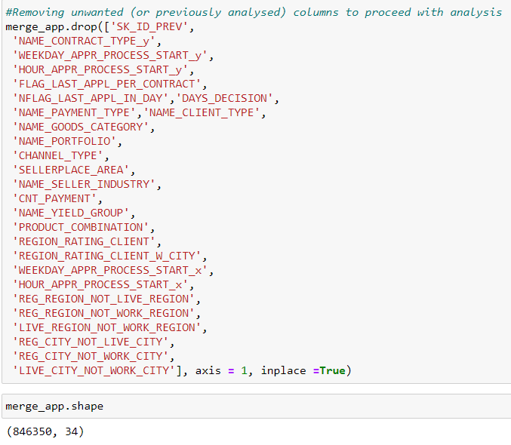
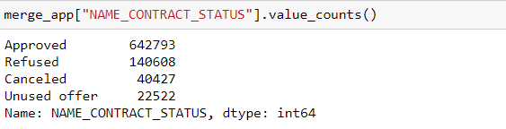
Merging the previous_application.csv dataset with application_data.csv using an inner join.
Removing few unwanted and previously analysed columns from which inferences have already been derived.
Shape of the dataset after removing all unwanted columns:
846350 rows and 34 columns.
Important variable for this dataset mentioning the past status of the applicants(Not mentioning this variable as target variable to avoid confusion): NAME_CONTRACT_STATUS

Slide 28
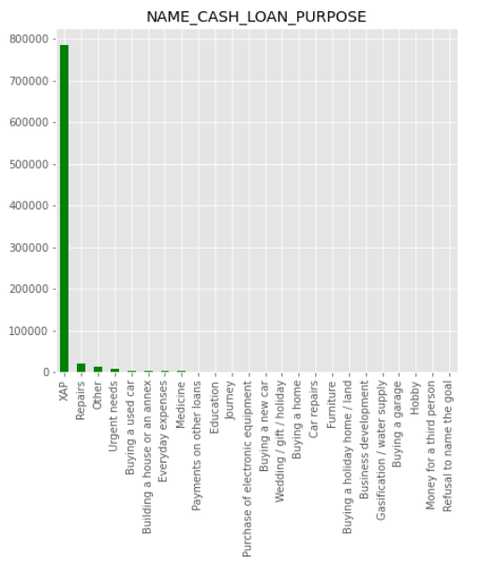
Because of the presence of XAP in NAME_CASH_LOAN_PURPOSE, the data is extremely biased towards it and hence analysis on other variables is not possible. Hence dropping the rows with reason XAP(Since visualizing other variables using these rows was not leading to any pattern as well).

Slide 29
Segmented the merged data set with Target=0(Non defaulters) and Target=1(Defaulters) for Univariate and Bi-variate analysis.

Slide 30
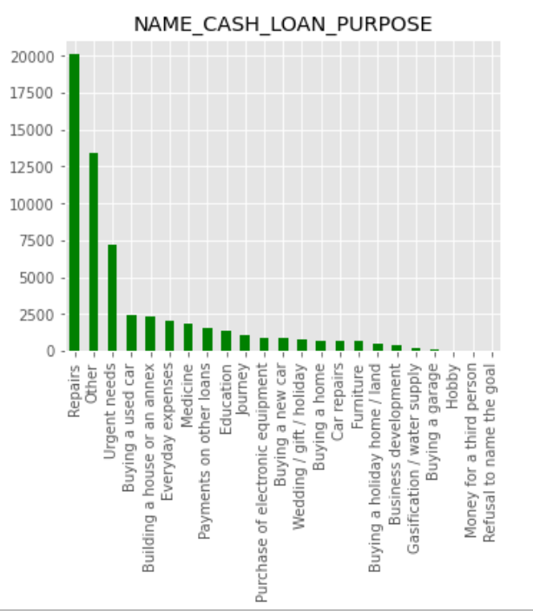
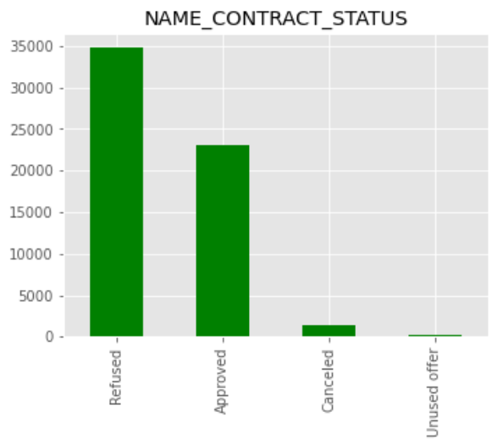
Analysis on Unsegmented data(merged-data)
Loans have been requested maximum for Repairs, Urgent needs and unspecified categories. There are almost no loans issued for a third person or because of customer refusal to reveal the objective of taking a loan.
Maximum number of loans applied by existing customers previously have been refused.

Slide 31
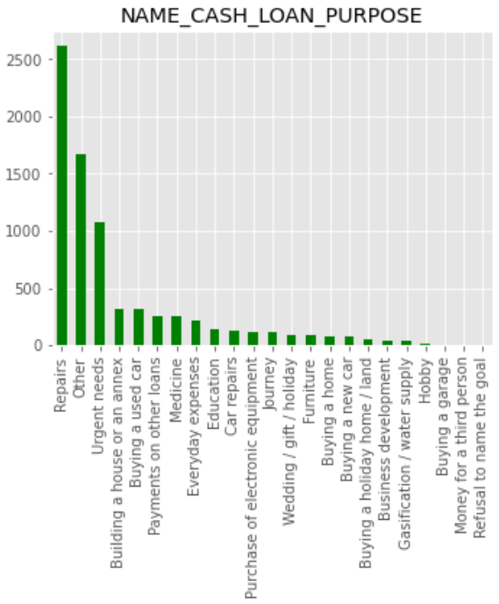
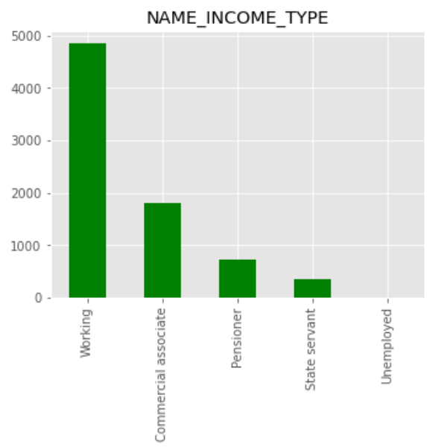
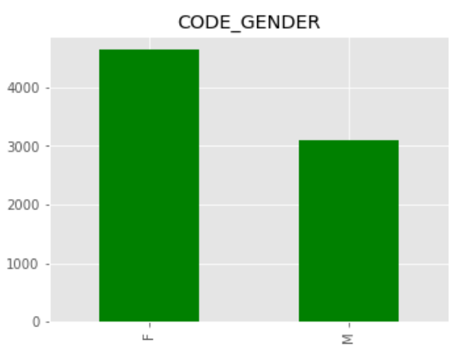
Analysis on segmented data(Defaulters):
Defaulters majorly belong to the Working category, have applied maximum number of times for loans on Repairs or other purpose and females show a significantly higher trend.

Slide 32
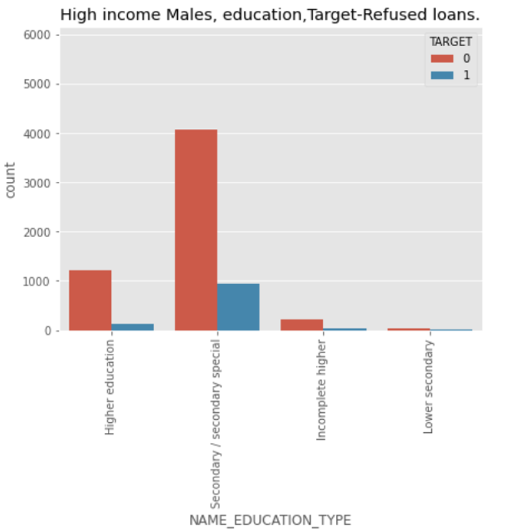
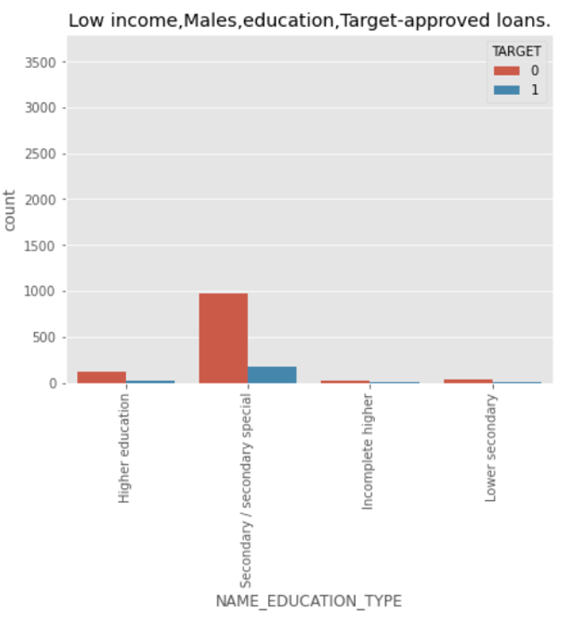
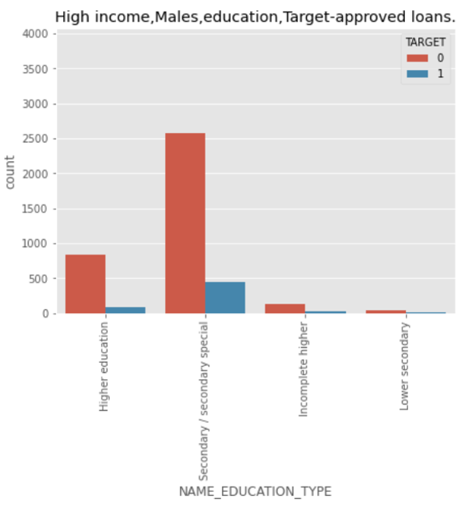

Males with high income and secondary education are more likely to have difficulties while paying back the amount or default.
This ratio is followed by males with low income and then females with high income and the females with low income.

Slide 33

Highest percentage of defaulters can be observed in case where Cash loans have been requested for Repairs. Highest percentage of Refusal of loans also is in the same category.
Based on proportionally high defaulters, more care should be taken while giving loans for repairs, other purposes, buying a used car, buying a house or an annex.

Slide 34

Refusal of loans is highest for customers earning a high income. This rate is significantly high for people falling into the age group of 30-40 years.

Slide 35

In case of refused loans, a HUGE-HUGE proportion of applicants were refused loans even if they wouldn’t have ended defaulting across all age groups. These applicants can be reconsidered for disbursing loans.
In case of approved loans, the ratio of applicants paying the amounts to not paying the amounts are same in the age group of 30-40 and 40-50.

Slide 36

The ratio of applicants who will pay their amounts on time to defaulters are almost same in case of approved and refused loans which seems somewhat of an efficiency problem. The rules and parameters need to be more strict while approving loans.

Slide 37

Out of all the loans the bank has approved, the bank has made proportionally more losses when they have approved loans to males.
The ratio of Refused loans is higher for defaulting males, although the count of applications shows a higher trend in female population.

Slide 38

A very high correlation is observed between Application Amount and the amount of the goods and between Application Amount and the credit amount from already processed loans. Also, we can observe a correlation trend similar to the one we observed while analysing application data.

Slide 39





We can observe a similar correlation trend for all loans previously issued to existing customers irrespective of the status of the loan, even though the orders might change slightly in each case.

Slide 40
Recommendations:
Based on the inferences derived earlier using EDA, below are few recommendations that will improve business strategies:
The ratio of applicants who will pay their amounts on time to the applicants having difficulties to pay their amounts on time are almost same in case of approved and refused loans. This is an efficiency problem which if kept the same way will compound the losses, the bank is facing . The rules and parameters need to be more strict while approving loans and while rejecting loans, the concerned officials need to go through other parameters to conclude if the person has a high chance of paying the amounts.
The bank has lost quite a good amount of profits by not approving revolving loans to applicants who would have paid the installments on time. The bank needs to increase their revolving loans number so as to derive continuous profits from the same depending on the amount of cash reserve the bank has.
Males with high income and secondary education are more likely to have difficulties while paying back the amount or default. Hence while approving their loans, more attention to detail needs to be given.
Approve more to applicants with more high annual income, secondary and high educated and less credit amount. This category is the least likely to default.
Maximum number of loans applied by existing customers previously were refused. So now when they have applied again, if total income has imcreased or credit amount has decreased or the annuity has decreased such that now the payment is possible- then loans can be approved to them. Also if now the target variable for those applicants shows 0- loans can be approved for them.

